Slide 2
SLS2 beam commissioning – Plans and supporting simulations
M. Aiba

Slide 3
Commissioning phases
Phase 1 – Linac, booster and transfer line commissioning
Phase 2 – First turn in storage ring
Phase 3 – Second turn and multi turn
Phase 4 – Accumulation, basic feedbacks and linear optics
Phase 5 – Nominal beam current with advanced settings and feedbacks
Phase 6 – Insertion device and collimator setup, making first photon beams
Phase 7 – Finalization
Two weeks for Phase 0, excluding linac commissioning
Two and half months for the rest
Another three months available in parallel to the beamline commissioning

Slide 4
Error model
Correlated misalignment model
Girder absolute misalignment = 60 μm rms
Girder to girder (joint play) = 20 μm rms
Element to element = 30 μm rms
Roll error, 300 μrad for magnet
2 sigma cut
BPM electronic offset/roll error
Offset = 300 μm rms
Roll error 10 mrad
2 sigma cut
BPM noise
Trajectory mode: ~50 μm rms ? (error can be significantly smaller by repeating measurement)
Orbit mode: ?
Magnetic field error
All magnet strength, 0.2% rms
2 sigma cut

Slide 5
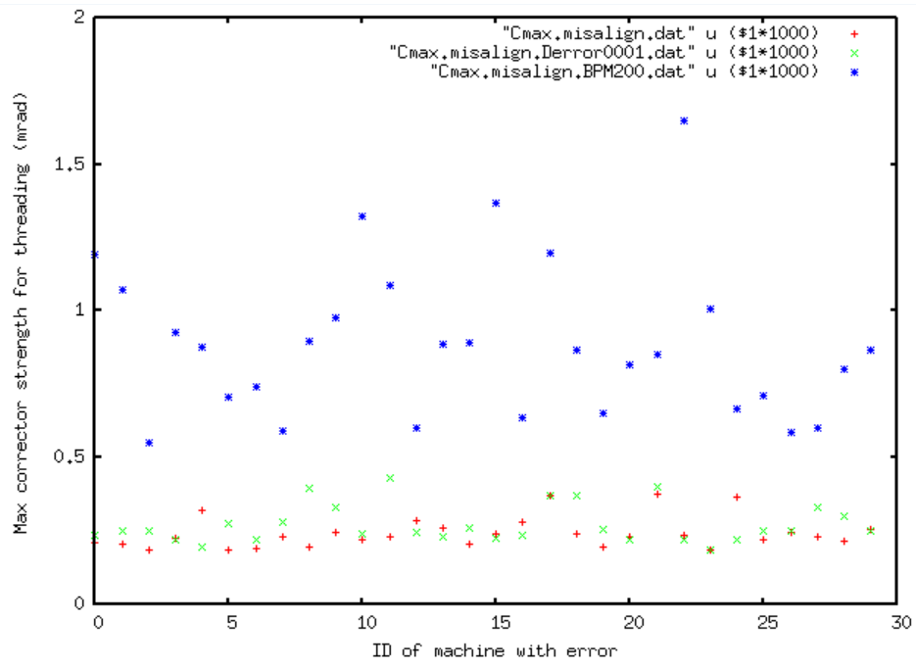
Phase 2: First-turn trajectory threading
Turn off sextupoles and octupoles
Otherwise trajectory response matrix is heavily modified by feed-down
Threading is impossible…
Corrector strengths too high due to BPM electronic offsets
First ‘Damn it’ at the very beginning
Maximum corrector strength
for trajectory threading
(simulation for various random seeds)
Only misalignment
Misalignment + 0.1% dipole error
Misalignment + BPM offset
(500 mrad, exaggerated)
Corrector strength limit

Slide 6
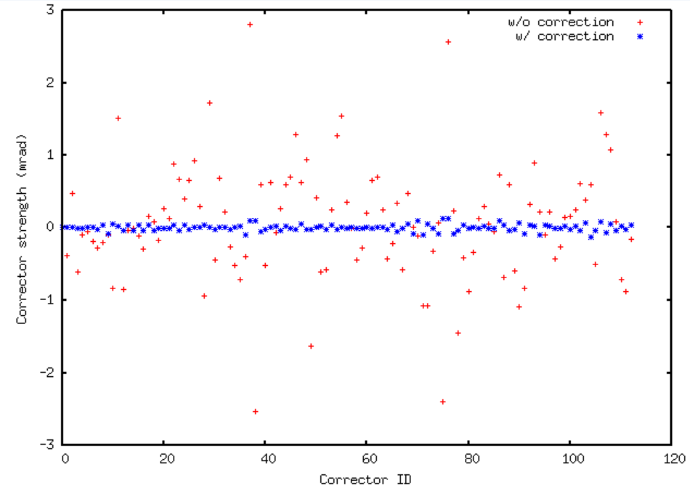
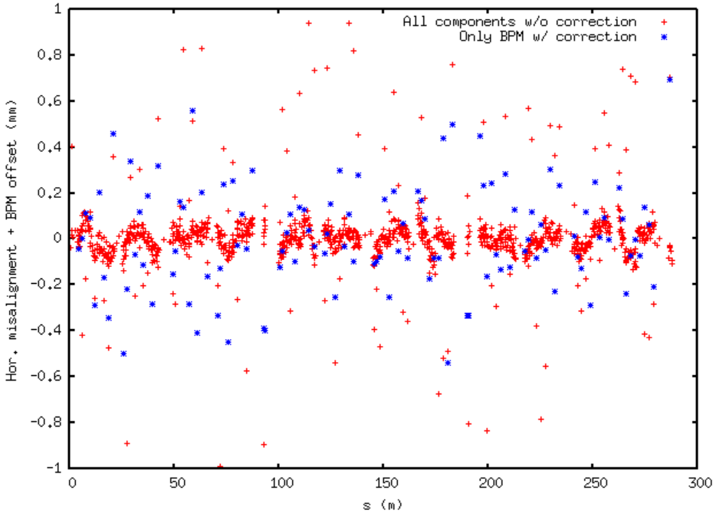
“Magic” to enable threading (BPM offset error correction)
Injecting beam and recording the trajectory
Computing corrector strengths to correct the trajectory
From the above corrector pattern, finding BPM offsets using a response matrix of corrector strengths to BPM offsets
Works for 200--500 μm BPM offset
Corrector strength along the ring
w/ and w/o offset correction
Misalignment + offset (in case of BPM)
All components before BPM offset correction
Only BPM after BPM offset correction
Threading becomes possible after BPM offset correction!
BPM offset is approximately reduced by half

Slide 7
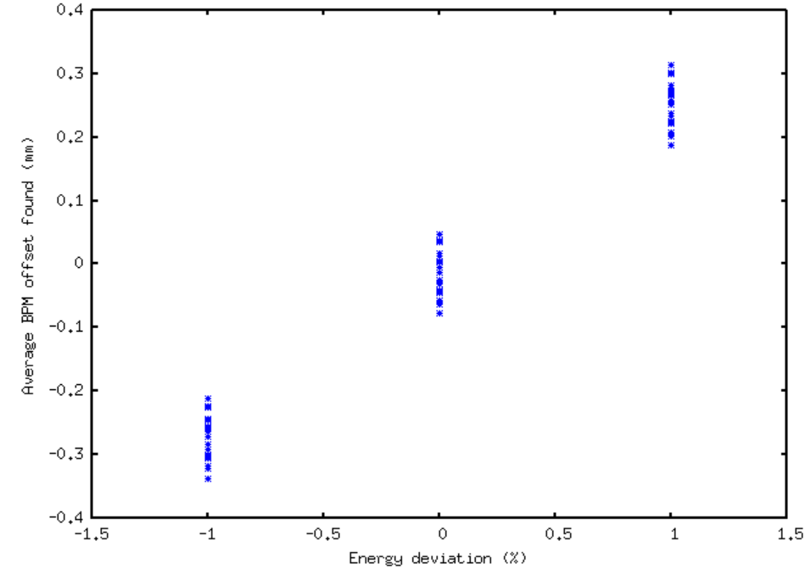
Injection beam energy calibration
The average over the inferred hor. BPM offsets is correlated to the injection bean energy deviation
Simulation showed that the injection beam energy can be found with a good precision, <0.2% if no systematic offset (non zero average offset)
Averaged BPM offset vs. Injection beam energy deviation
20 simulations each for
-1, 0, +1% energy deviation

Slide 8
Polarity checks
Threading still does not work if any polarity of BPM, corrector and quad is wrong
Polarity check is therefore done in parallel (looking into trajectory responses to correctors)
Note
It is likely that the injection beam does not reach to the end of first turn with no correction: Micado-style trajectory correction may be applied to bring the trajectory to 1 mm level with reasonable corrector strength (this was examined by simulation)
Time estimation
1 shift: Possibly more shifts if many wrong polarities

Slide 9
Phase 3: Second-turn and multi-turn
Equalizing the first turn and second turn trajectory
Since the BPM offsets have been significantly reduced, and the trajectory is under full control, the equalizing is straightforward approach rather than simultaneous 1st and 2nd turn trajectory minimization
Skip two injection straight BPM, which are not included in the magic (connecting the orbit from ARS12_DBPM_588 to ARS01_DBPM_108 directly)
Procedure
Turning off the kicker bump
Correcting the injected beam trajectory (-7mm at the septum exit) using the correctors after the first arc (mainly 6 correctors after ARS01-MCOX-5270) ← This is equivalent to an on-axis injection for the first beam, and no kicker bump at the beginning of the second turn
Equalizing the first turn and the second turn trajectory (excluding the BPM in the straight section)
Setting the correctors in Sectors 1 and 2 back
Turning on the kicker bump

Slide 10
Note: Fast injection kicker in Sector 2 could be alternatively used to achieve the second and muti-turn but may not be strong enough for complete on-axis injection and equalizing
Time estimation: 0.5~1 shift

Slide 11
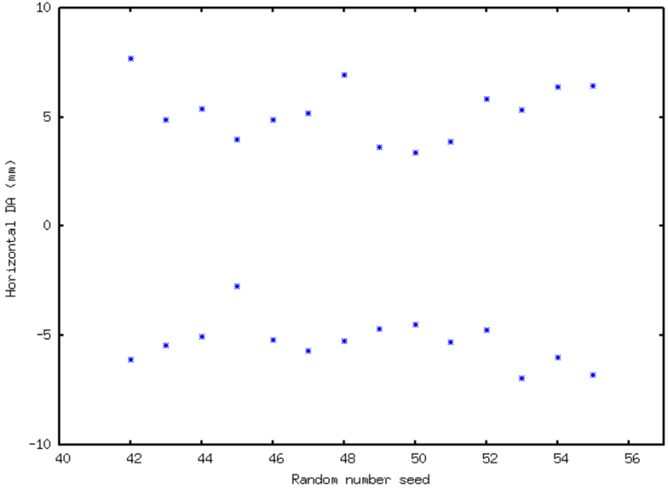
Phase 4: Multi-turn to accumulation
Turning on sextupoles and octupoles
Dynamic aperture from commissioning simulation is promising for accumulation (at least with slow + fast kickers)
Sextupoles and octupoles can be turned on in one-go: typical orbit change <100 μm
Dynamic aperture after
turning on multipoles
(100 turn)

Slide 12
Setting up RF
What are available signals to adjust phase?
Injection tuning
Checking BPM orbit mode with expert
Rough collimator setup
Note
Commissioning of ICT and on-line lifetime monitor can be started in parallel as soon as we have stored beam.
The same for SR beam size monitors? (Cigdem)
Vacuum scrubbing comes for free but we pay more attention to the vacuum pressure along the ring as soon as we have stored beam
Time estimation
~5 shifts

Slide 13
Phase 4: Beam dump
The first thing to do when we achieve stored beam
Beam dump procedure needs to be discussed and determined…
Time estimation: 1 shift

Slide 14
Phase 4: Basic feedback
Slow orbit feedback and RF frequency feedback
Time estimation: 1~2 shifts

Slide 15
Phase 4: BPM BBA with stored beam
Commissioning of tune monitor (One of BPMs?)
BBA with low current stored beam but as high as possible
Procedure similar to SLS
Expected precision ~5 μm rms
Simulation of BBA itself is skipped since it is well established procedure
Tracking simulation showed that DA can be recovered by BBA for bad seeds (for #45, DA at negative x side improved from -2.7 mm to -6.9 mm)
BBA procedure requires slow-orbit feedback? (Michael)
Time estimation
~5 shifts for the first time (repeated later)
Cf. ~1.5 shift at the SLS with less number of BPMs… Need a modification to speed it up?

Slide 16
Phase 4: Linear optics correction
LOCO style optics correction is examined by simulation
Beta beat correction to 1% or better is achieved
Horizontal dispersion needs to be corrected simultaneously
Rough chromaticity measurement can be done as a by-product of dispersion measurement
If very much off, sanity check of sextupole families here (original plan in Phase 4)
Time estimation
2~3 shifts for the first time (repeated later)

Slide 17
Phase 5: Vertical emittance
Procedure
Vertical girder realignment to suppress spurious vertical dispersion and coupling (might be skipped if the vertical corrector strength is already low)
Coupling correction; Response matrix measurement is already established from the previous phase
Applying the design skew quad setting
Measuring response matrix again for confirmation
Checking the vertical beam size with SR beam size monitor?
Time estimation
2~3 shifts

Slide 18
Phase 5: Chromaticity
Chromaticity measurement and correction
Sanity check of sextupole families, i.e., measuring chromaticity changes by varying sxtupoles family by family
Wrong polarity can be detected by comparing the prediction from the optics model
Time estimation: 1~2 shifts

Slide 19
Phase 5: Full current trial
At this point, we are ready to test a full current accumulation
Commissioning of third harmonic cavity
500 MHz cavity tuning (not necessary for HOM damped cavity?)
Bunch-by-bunch feedback essential?
With high current, nonlinear optics tuning
Time estimation: ~5 shifts

Slide 20
Phase 6: IDs and collimators
Precise collimator setup
Turning on and off IDs one by one
Beam dump procedure, normal and emergency dump
Time estimation: 3~4 shifts

Slide 21
Phase 6: First photon beam
Shifts together with beamline users
Time estimation: 1~2 shifts

Slide 22
Phase 7: Finalization
Bunch-by-bunch feedback (if not done in Phase 4)
Feedforward table implementation, i.e., ID gaps vs correctors
Refinement of the previous commissioning steps
Time estimation: Not applicable. We use the time left and refinement in parallel to the beamline commissioning (see the last slide)

Slide 23
Commissioning policy
Dry run/check before beam commissioning as much as possible, both hardware and software
Beam commissioning and system commissioning in parallel most of time
No shortcut, following step by step the plan
No photon beam until Phase 5

Slide 24
Question: man power planning
Estimated number of shifts ~ 34 shifts (no reserve)
Shift planning
‘1 shift per day, only on weekdays’ would be practical and compatible with the above estimation
During the night and weekend, vacuum scrubbing by operators
Once the dedicated accelerator commissioning phase is completed, we may take night shift for refinement while the beamline commissioning is performed during the day time.

